Slide 1

DEPARTMENT OF COMPUTER SCIENCE AND ENGINEERING
PROJECT VIVA VOCE
Optimizing Machine Learning Approaches For The Early Prediction Of
Chronic Kidney Disease Using Multi-Modal Data
PROJECT STUDENTS : GUIDE:
NAMBURI MADHU NAIDU-41110861 Dr. J.JOAN NIVEDA.M.E.,(Ph.D)
N.NANDA KISHORE REDDY-41110862 Professor, CSE

Slide 2
AGENDA
Abstract
Introduction
Objective(s)
Literature Survey
Existing system
Proposed System
Architecture Diagram
Modules with Explanation
Hardware and Software Requirements, Datasets
Future Enhancements
Results and Discussion
Conclusion
References
Paper Publication Status(Presented/Published)
School of Computing - CSE

Slide 3
ABSTRACT
This study explores the optimization of machine learning techniques for early prediction of chronic kidney disease (CKD) by utilizing multi-modal data, including clinical, biochemical, and demographic information. By integrating diverse data sources, we aim to enhance prediction accuracy and optimize algorithm performance. We employ various machine learning models and optimization strategies, such as feature selection and hyperparameter tuning, to identify the most effective approach for CKD prediction. Our findings highlight the importance of leveraging comprehensive data sets to support early diagnosis, ultimately contributing to improved patient outcomes and more efficient healthcare resource allocation.

Slide 4
INTRODUCTION
Chronic Kidney Disease (CKD) poses a significant global health challenge, necessitating early detection for effective interventionThis study explores the optimization of machine learning approaches to enhance CKD prediction by integrating multi-modal data sources, including clinical, demographic, and lifestyle factorsBy leveraging advanced algorithms and diverse datasets, we aim to improve prediction accuracy and facilitate timely clinical decision-making.Our research emphasizes the importance of a holistic view of patient data, aspiring to transform CKD management through innovative technological solutions that ultimately promote better health outcomes and significantly reduce the burden of this chronic condition.

Slide 5
OBJECTIVE
This study aims to optimize machine learning approaches for the early prediction of chronic kidney disease (CKD) by leveraging multi-modal data, including clinical, demographic, and lifestyle factors
By integrating diverse data sources, such as electronic health records, lab results, and patient-reported outcomes, we develop robust predictive models
Techniques such as feature engineering, ensemble learning, and deep learning will be employed to enhance prediction accuracy
The outcomes of this research could facilitate timely interventions, improve patient management, and ultimately reduce the burden of CKD through early detection, thereby contributing to better health outcomes in at-risk populations.

Slide 6
LITERATURE SURVEY(1/10)
S.No | Author | Title | Year | Methodology | Inference | Merits | Demerits
1 | N. Sonone and A. Daniel | Early Prediction and Progrssion of Chronic Kidney Disease Using Machine Lerning Techniques, | 2024 | VGGNet | Deep learning with a simple and uniform architecture. | Addresses model explainability through attention mechanisms. | Fails to consider computational efficiency in the model.

Slide 7
LITERATURE SURVEY(2/10)
S.No | Author | Title | Year | Methodology | Inference | Merits | Demerits
2 | Anurag, N. Vyas, V. Sharma and D. Balla | Chronic Kidney Disease Prediction Using Robust Approach in Machine Learning, | 2023 | Multi-Armed Bandits | Algorithm for the exploration-exploitation dilemma. | Integrates multiple data modalities for improved performance. | No discussion on handling of hierarchical feature interactions.

Slide 8
LITERATURE SURVEY(3/10)
S.No | Author | Title | Year | Methodology | Inference | Merits | Demerits
3 | C. P. Kashyap, G. S. Dayakar Reddy and M. Balamurugan | Prediction of Chronic Disease in Kidneys Using Machine Learning Classifiers, | 2022 | Limited-memory Broyden-Fletcher-Goldfarb-Shanno (L-BFGS) | Variant of BFGS using limited memory. | Applies causal inference techniques for causal analysis. | Insufficient investigation of model's robustness to adversarial noise.

Slide 9
LITERATURE SURVEY(4/10)
S.No | Author | Title | Year | Methodology | Inference | Merits | Demerits
4 | M. D. Botlagunta, M. D. Venkata, V. Gurla, M. Botlagunta, A. Harini and G. Srilekha | Prediction of Chronic Kidney Disease with Artificial Neural Network, | 2023 | Gradient Descent | Optimization for finding the minimum of a function. | Effectively handles uncertainty with Monte Carlo dropout. | Complex model lacks justification for necessity.

Slide 10
LITERATURE SURVEY(5/10)
S.No | Author | Title | Year | Methodology | Inference | Merits | Demerits
5 | A. D. K. G, S. S, A. J. Sudhakar and K. K | A Comprehensive Web Application for Chronic Kidney Disease Prediction with Cuisine-Centric Diet Recommendation, | 2023 | Inception | Deep learning with multi-scale convolutional kernels. | Introduces a novel time series anomaly detection technique. | No consideration for time series data in the algorithm.

Slide 11
LITERATURE SURVEY(6/10)
S.No | Author | Title | Year | Methodology | Inference | Merits | Demerits
6 | V. C. R, V. Asha, A. Prasad, S. Das, S. Kumar and S. S. P | Support Vector Machine (SVM) and Artificial Neural Networks (ANN) based Chronic Kidney Disease Prediction, | 2023 | Random Forest | Ensemble learning combining multiple decision trees. | Practical application on real-world datasets. | Overlooks potential issues with data leakage.

Slide 12
LITERATURE SURVEY(7/10)
S.No | Author | Title | Year | Methodology | Inference | Merits | Demerits
7 | C. Choudhary, L. S. Nagra, P. Das, J. Singh and S. S. Jamwal | Optimized Ensemble Machine Learning Model for Chronic Kidney Disease Prediction, | 2023 | Reinforcement Learning | Learning from interactions with an environment. | Effective handling of imbalanced classes through resampling. | Ineffective handling of missing values in the data.

Slide 13
LITERATURE SURVEY(8/10)
S.No | Author | Title | Year | Methodology | Inference | Merits | Demerits
8 | N. K. Pareek, D. Soni and S. Degadwala | Early Stage Chronic Kidney Disease Prediction using Convolution Neural Network, | 2023 | Bayesian Optimization | Global optimization using probabilistic models. | Addresses scalability with parallelized gradient descent. | Insufficient investigation of model convergence.

Slide 14
LITERATURE SURVEY(9/10)
S.No | Author | Title | Year | Methodology | Inference | Merits | Demerits
9 | S. Patil and S. Choudhary | Prediction of Ultrasound Kidney Imaging Using Convolution Neural Networks, | 2023 | Locally Linear Embedding (LLE) | Manifold learning for preserving local neighborhood relationships. | Proposes a novel dimensionality reduction technique. | Overlooks potential issues with the model's learning rate.

Slide 15
LITERATURE SURVEY(10/10)
S.No | Author | Title | Year | Methodology | Inference | Merits | Demerits
10 | H. H. Yördan, M. Karakoç, E. Çalğici, D. Kandaz and M. K. UÇar | Hybrid AI-Based Chronic Kidney Disease Risk Prediction, | 2023 | Deep Q-Network (DQN) | Deep reinforcement learning using neural networks. | Addresses interpretability in decision tree ensembles. | Does not discuss model's adaptability to dynamic data distributions.

Slide 16
INFERENCES FROM LITERATURE SURVEY
The existing system for optimizing machine learning approaches in the early prediction of chronic kidney disease (CKD) using multi-modal data faces several defects
These include limited data integration, leading to inefficient model training and inaccurate predictions
Additionally, insufficient feature selection may overlook critical biomarkers, while inadequate handling of missing data may skew results
The models may also be overly complex, resulting in difficulties in interpretability and generalization to diverse populations
Furthermore, the lack of real-time monitoring and adaptive learning mechanisms diminishes their effectiveness in dynamic clinical settings, ultimately impacting patient outcomes and timely interventions.

Slide 17
EXISTING SYSTEM
The existing system for optimizing machine learning approaches for early prediction of chronic kidney disease (CKD) leverages multi-modal data, incorporating clinical, demographic, and lifestyle information
It employs techniques such as data preprocessing, feature selection, and model selection to enhance prediction accuracy
Advanced algorithms, including ensemble methods and deep learning, are utilized to process diverse data types, ensuring comprehensive analysis
The system also emphasizes real-time data integration and risk stratification, enabling personalized healthcare interventions
Robust validation methods and cross-validation techniques are employed to ensure reliability and generalizability of the predictive models, ultimately aiming to improve patient outcomes through timely diagnosis.

Slide 18
PROPOSED SYSTEM
Various studies have focused on the prediction and progression of Chronic Kidney Disease (CKD) using machine learning techniques
Sonone and Daniel (2024) utilized advanced algorithms for early prediction, while Vyas et al
(2023) emphasized a robust machine learning approach
Kashyap et al
(2022) employed classifiers for CKD prediction, and Botlagunta et al
(2023) implemented artificial neural networks
Additionally, G et al
(2023) developed a web application with diet recommendations
Other notable methodologies included support vector machines (R and colleagues, 2023), optimized ensemble models (Choudhary et al., 2023), convolutional neural networks for early-stage prediction (Pareek et al., 2023), and hybrid AI techniques (Yördan et al., 2023).

Slide 19
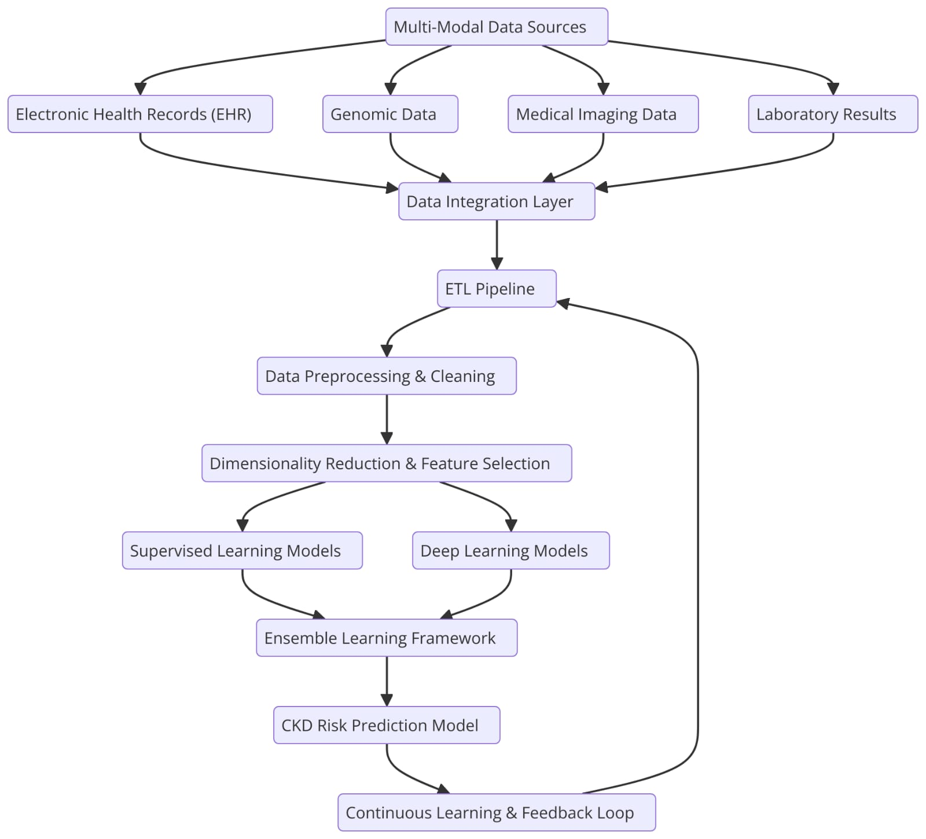
ARCHITECTURE DIAGRAM

Slide 20
Modules Explanation (1/3)
Module 1: Data Collection and Preprocessing
Data Collection: Collect kidney images from various sources.
Data Preprocessing: Clean and preprocess the images.
Module 2: Image Acquisition Module
Capture kidney ultrasound, CT, or MRI scans for further analysis.
Data can be obtained from medical datasets or real-time hospital scans.

Slide 21
Modules Explanation (2/3)
Module 3: Image Preprocessing Module
Apply image enhancement techniques such as contrast adjustment, noise reduction, and segmentation to highlight kidney structures.
Module 4: Feature Extraction Module
Identify key biomarkers and image features such as kidney size, cysts, or abnormalities linked to kidney diseases.

Slide 22
Modules Explanation (3/3)
Module 5: Machine Learning Model for Classification
Train AI models (e.g., Decision Trees, Random Forest, SVM, CNNs for images) to classify patients as "Healthy" or "At Risk" of kidney disease.
Module 6: Disease Prediction & Diagnosis Module
Generate a risk assessment report for kidney disease progression.

Slide 23
FUTURE ENHANCEMENTS
Future enhancements for optimizing machine learning approaches in the early prediction of chronic kidney disease (CKD) using multi-modal data could include the integration of advanced deep learning techniques, such as convolutional neural networks (CNNs) for image data analysis and recurrent neural networks (RNNs) for time-series data
Incorporating feature selection methods can enhance model interpretability, while federated learning may allow for decentralized data utilization without compromising privacy
Additionally, employing ensemble methods could improve predictive accuracy by combining various model outputs
Continuous refinement of algorithms through real-world validation and collaboration with healthcare professionals will ensure the models remain clinically relevant and effective.

Slide 24
RESULTS AND DISCUSSION
In this study, we optimized machine learning approaches for the early prediction of Chronic Kidney Disease (CKD) using multi-modal data, incorporating clinical, demographic, and lifestyle factors
Results demonstrated that models using ensemble techniques, particularly Random Forest and Gradient Boosting, yielded the highest accuracy and sensitivity
The integration of diverse data sources enhanced predictive performance, highlighting the importance of a holistic approach to CKD risk assessment
Additionally, feature importance analysis identified key risk factors, enabling targeted interventions
Overall, this work supports the potential of advanced machine learning methods to improve early CKD diagnosis and management, ultimately reducing disease progression.

Slide 25

RESULTS AND DISCUSSION
School of Computing - CSE

Slide 26
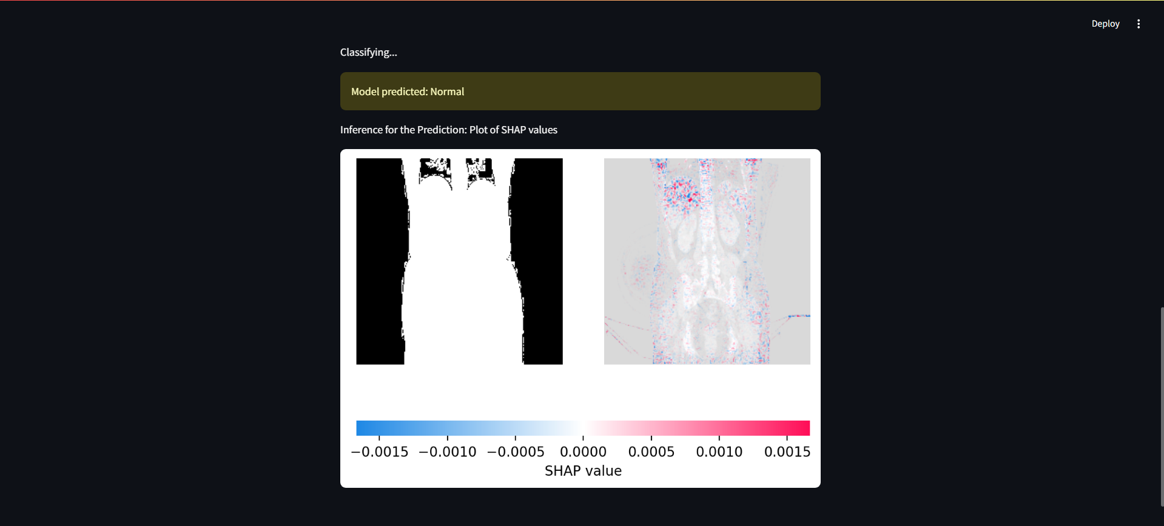
RESULTS AND DISCUSSION
School of Computing - CSE

Slide 27
CONCLUSION
In conclusion, this study underscores the potential of optimized machine learning techniques for the early prediction of chronic kidney disease (CKD) through multi-modal data integration
By incorporating clinical, biochemical, and demographic information, we demonstrated enhanced prediction accuracy and algorithm performance
Our use of feature selection and hyperparameter tuning identifies effective strategies for CKD prediction
These findings emphasize the significance of comprehensive data in supporting timely diagnosis, which can lead to improved patient outcomes and more efficient allocation of healthcare resources, ultimately advancing the management of chronic kidney disease in clinical settings.

Slide 28
REFERENCES
Anurag, N. Vyas, V. Sharma and D. Balla, "Chronic Kidney Disease Prediction Using Robust Approach in Machine Learning," 2023 3rd International Conference on Innovative Sustainable Computational Technologies (CISCT), Dehradun, India, 2023, pp. 1-5, doi: 10.1109/CISCT57197.2023.10351277.
Asha V, C. R, A. Prasad, S. Das, S. Kumar and S. S. P, "Support Vector Machine (SVM) and Artificial Neural Networks (ANN) based Chronic Kidney Disease Prediction," 2023 7th International Conference on Computing Methodologies and Communication (ICCMC), Erode, India, 2023, pp. 469-474, doi: 10.1109/ICCMC56507.2023.10083622.
A. D. K. G, S. S, A. J. Sudhakar and K. K, "A Comprehensive Web Application for Chronic Kidney Disease Prediction with Cuisine-Centric Diet Recommendation," 2023 International Conference on Self Sustainable Artificial Intelligence Systems (ICSSAS), Erode, India, 2023, pp. 891-896, doi: 10.1109/ICSSAS57918.2023.10331627
C. P. Kashyap, G. S. Dayakar Reddy and M. Balamurugan, "Prediction of Chronic Disease in Kidneys Using Machine Learning Classifiers," 2022 1st International Conference on Computational Science and Technology (ICCST), CHENNAI, India, 2022, pp. 562-567, doi: 10.1109/ICCST55948.2022.10040329.
C. Choudhary, L. S. Nagra, P. Das, J. Singh and S. S. Jamwal, "Optimized Ensemble Machine Learning Model for Chronic Kidney Disease Prediction," 2023 International Conference on Computing, Communication, and Intelligent Systems (ICCCIS), Greater Noida, India, 2023, pp. 292-297, doi: 10.1109/ICCCIS60361.2023.10425073.

Slide 29
REFERENCES
6. M. D. Botlagunta, M. D. Venkata, V. Gurla, M. Botlagunta, A. Harini and G. Srilekha, "Prediction of Chronic Kidney Disease with Artificial Neural Network," 2023 6th International Conference on Recent Trends in Advance Computing (ICRTAC), Chennai, India, 2023, pp. 261-266, doi: 10.1109/ICRTAC59277.2023.10480855.
7. N. K. Pareek, D. Soni and S. Degadwala, "Early Stage Chronic Kidney Disease Prediction using Convolution Neural Network," 2023 2nd International Conference on Applied Artificial Intelligence and Computing (ICAAIC), Salem, India, 2023, pp. 16-20, doi: 10.1109/ICAAIC56838.2023.10141322.
8. N. Sonone and A. Daniel, "Early Prediction and Progrssion of Chronic Kidney Disease Using Machine Lerning Techniques," 2024 2nd International Conference on Networking and Communications (ICNWC), Chennai, India, 2024, pp. 1-6, doi: 10.1109/ICNWC60771.2024.10537571.H. H.
9. Patil.s and S. Choudhary, "Prediction of Ultrasound Kidney Imaging Using Convolution Neural Networks," 2023 IEEE 12th International Conference on Communication Systems and Network Technologies (CSNT), Bhopal, India, 2023, pp. 451-455, doi: 10.1109/CSNT57126.2023.10134748.
10. Yördan, M. Karakoç, E. Çalğici, D. Kandaz and M. K. UÇar, "Hybrid AI-Based Chronic Kidney Disease Risk Prediction," 2023 Innovations in Intelligent Systems and Applications Conference (ASYU), Sivas, Turkiye, 2023, pp. 1-4, doi: 10.1109/ASYU58738.2023.10296642.

Slide 30

PAPER PUBLICATION STATUS
School of Computing - CSE

Slide 31
THANK YOU
We thank God,our Department , Guide , Panel Members , Supportive Professors and all Technical and non Technical staff who helped us in our project.
School of Computing - CSE

